Slide 1
Pulse Sensor
Name:
Varun Gattani (32271)
Kalpesh Wagaskar(32272)
Madhur Zanwar(32273)

Slide 2
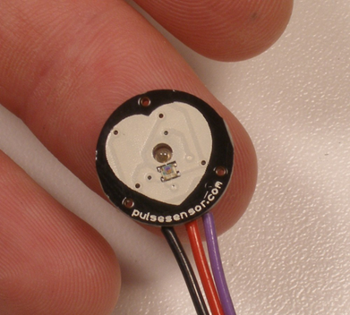
Pulse Sensor

Slide 3
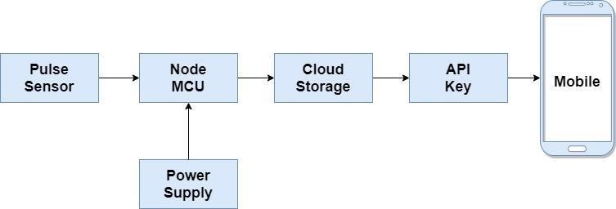
Block Diagram

Slide 4
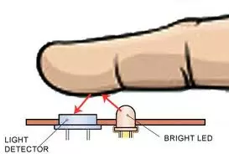
WORKING:
expansion and contraction of blood vessel
68 to 84 times a minute for an healthy person.
pass light on the finger and measure the intensity of light received by the receiver.
APPLICATIONS:
Live heart rate detection.
Blood pressure can be calculated using formula.

Slide 5
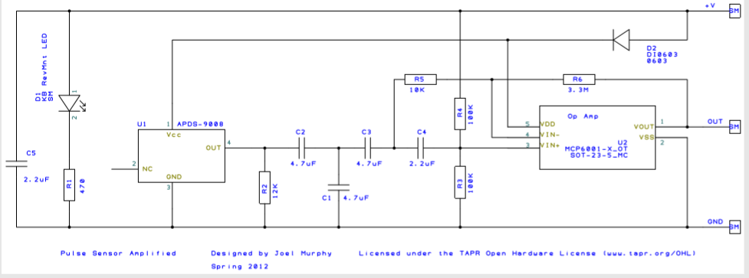
Construction:

Slide 6
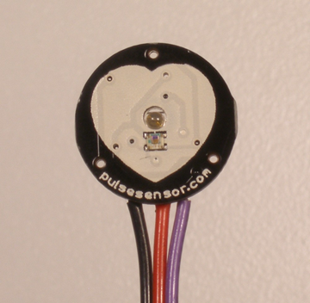
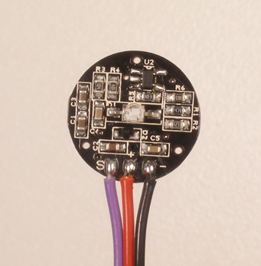
PIN CONFIGUARTION:
RED wire =+3V to +5 V
BLACK wire = GND
PURPLE wire= SIGNAL

Slide 7
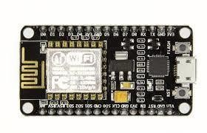
NodeMCU:
Low cost open source IoT platform
runs on the ESP8266 Wi-Fi from Espressif Systems
Functions of Arduino

Slide 8
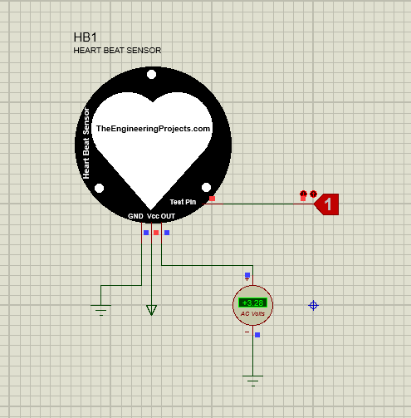
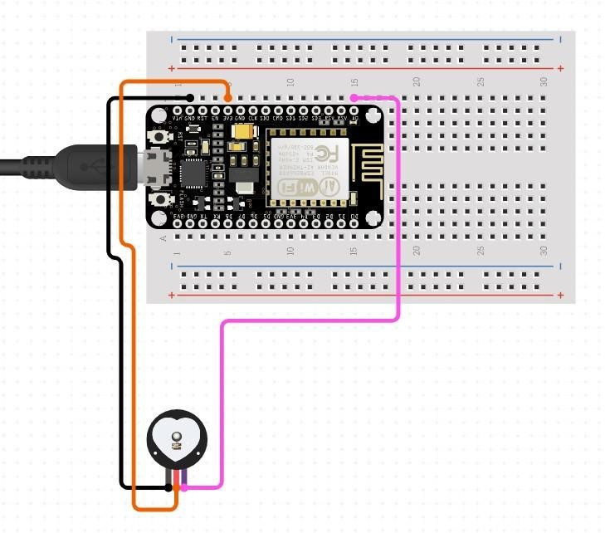
Simulation

Slide 9
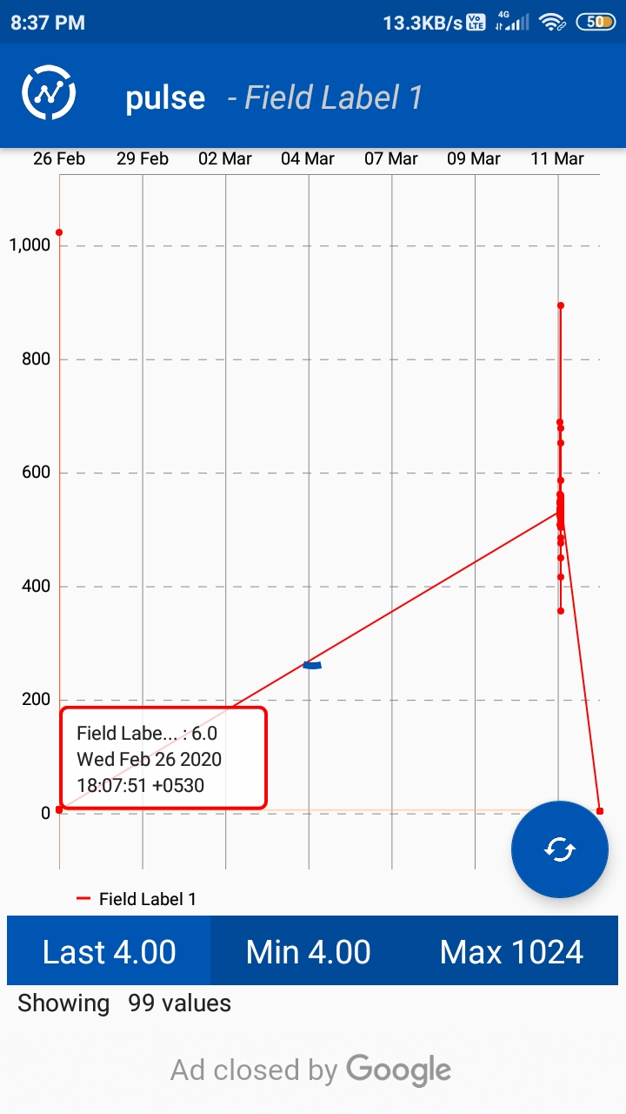
Fetching Data:
Using API key
Y-axis: Heart rate
X-axis : Time stamp
Updates every 16 seconds
Data in the attached screenshot is raw data

Slide 10
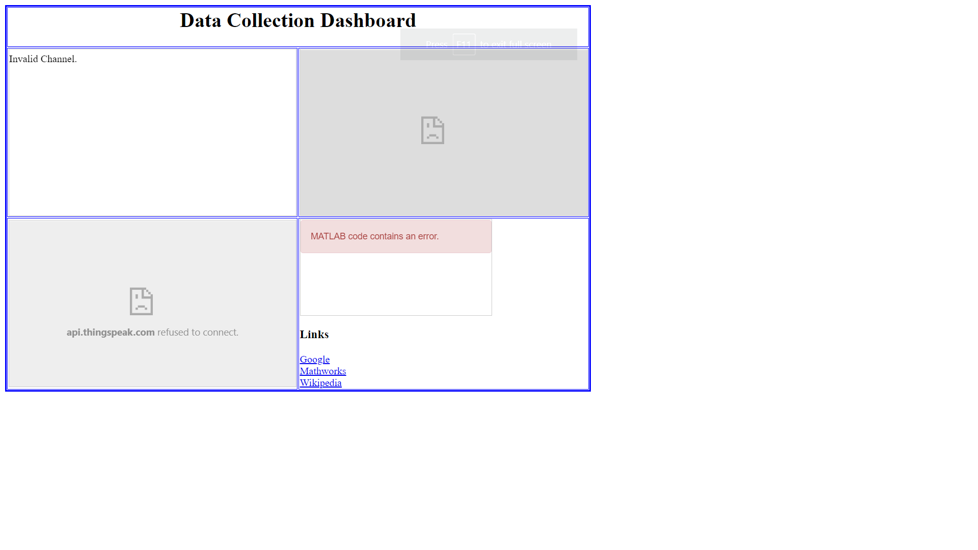

Slide 11
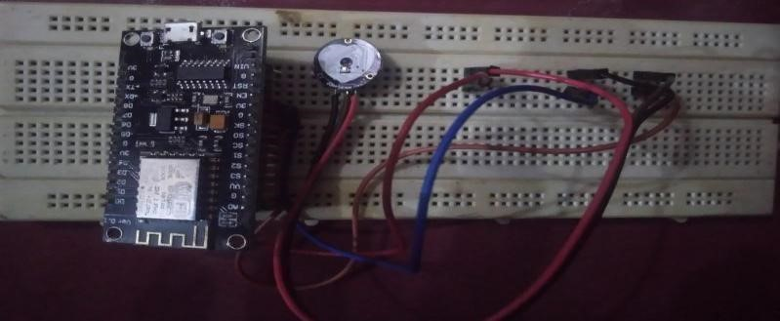
Implementation
Figure 3.
2
:
Breadboard
Testing
CODES

